Slide 1


Join a New Way of Working

Slide 2
What is Working Out Loud?
Notes:
What’s WOL?
For me: a way to meet people. A joy, a lifeline. Something that gave me purpose in the lockdown!

Slide 3
Working Out Loud is a…
Virtual Workplace Friendly!
Method
Peer support group
Answer 3 questions
Habits & Mindset
Safe Space
Practice & dedicate time
What is my objective?
Who is related?
How do I contribute?
Notes:
3 mins
So… what is WOL?
It’s a lot of things!
You get a Peer support group: 4-5 people.
Answer 3 questions for yourself: What, Who, How do I contribute?
Practice & Dedicate time: 1 hour/wk for 12 weeks.
Safe Space: you get this time to practice your contributions and receive candid feedback.
Employees develop & practice new skills while working remotely.
They create more connections across locations & departments, breaking down silos.
Participants get professional support along the way.
WOL has been increasingly popular in hundreds of companies and in over 60 countries worldwide since 2015: Bosch, SAP, Siemens and Deutsche Bank, to name a few.
Some great companies like BMW have even implemented it into their company strategy because Working Out Loud is helping their organization effectively developing their employees mindset and is supporting different use cases.

Slide 4
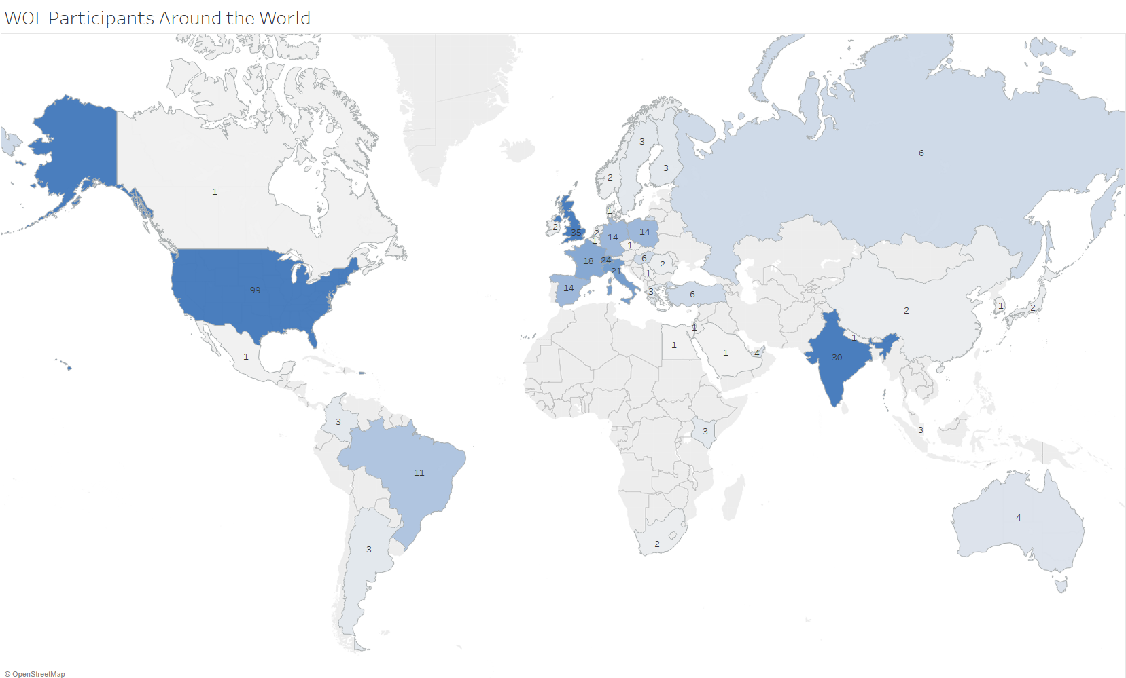
As of December 1st, 2020

Slide 6
How does the program work?

Slide 7





WOL is a self-organized learning journey
A WOL mentor will be available for questions & guidance
... by getting you into a rhythm
3 – 5
employees
(1 Circle)
1st meeting will be arranged for you
12
weeks
A self-organized
Peer Coaching
Circle
You meet with your Circle for 12 weeks, in Teams video calls
1 hour per
week
The Circle meets one hour a week + individual reflection time
1 Learning goal per person
1 guide
for every
week
Everyone pursues
his or her personal goal, which they try to achieve through networking
A short, simple guide will help you take small steps every week
Notes:
1 min
So how does it work now?
After you sign up, you are allocated into a circle of 3-5 people. The Circle meets for one hour per week over 12 weeks, via Microsoft Teams.
Each person chooses a personal goal where they want to make progress.
For every meeting, there is a structured guide with exercises and guided discussions.
Over this period employees reach their goals with the support of their colleagues and AT THE SAME TIME train new skills needed at a 21st century workplace and expand their network of meaningful relationships within our company.
So in total, you get 12 focused hours devoted to self-development and learning, with amazing results.

Slide 8
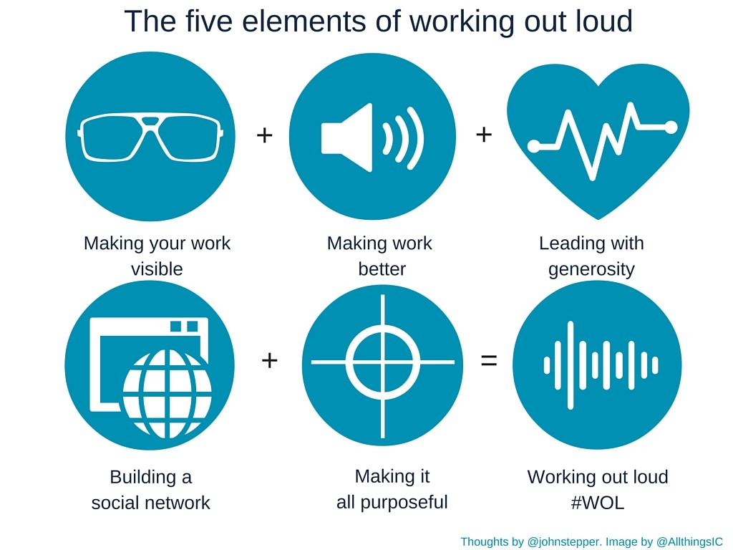


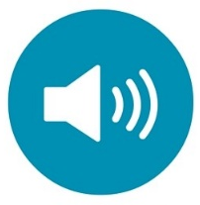
Five elements of #WOL
PURPOSEFUL
DISCOVERY
A GROWTH MINDSET
BUILDING
RELATIONSHIPS
LEADING WITH
GENEROSITY
BECOME VISIBLE
Behaviors + purpose to shape the new workplace culture
Notes:
1 min
There are five elements integrated into this learning program which support very well our new purpose and leadership behaviors at GE
Relationships are at the heart of WOL because the path to knowledge is via others.
Leading with Generosity is about making contributions and building trust over time, increasing the chances of cooperation and collaboration.
Purposeful Discovery means delivering with focus, because having a learning goal in mind serves to orient your activities.
Making you & your work visible: This isn’t about promoting yourself or trying to be popular. It’s about making it easier to come into contact with people related to your work, your goals, and your interests.
Finally, this is really about
Growth Mindset: Develop an open, curious approach to work & life and strive for continuous improvement.
When you graduate, you can also leverage a blossoming network of #WOL Alumni in GE with their own channel in Teams!

Slide 9

I’m so
grateful to be a part of the WOL community at GE!
One of my weekly highlights (team leader)
this approach made
me feel so good about everything I've learned when it comes to HR and "humanizing" our workplace
I have much more confidence
Such a great
experience to get
to know colleagues from different businesses after working for 10 years in GE Healthcare
makes the heart beats stronger

Slide 10

“I looked forward to the weekly session as a break from my regular tasks. It was refreshing to spend an hour not talking about "work".”
WOL Alumnus
Notes:
A testimonial I particularly liked!

Slide 11
Sounds great! How do I sign up?

Slide 12
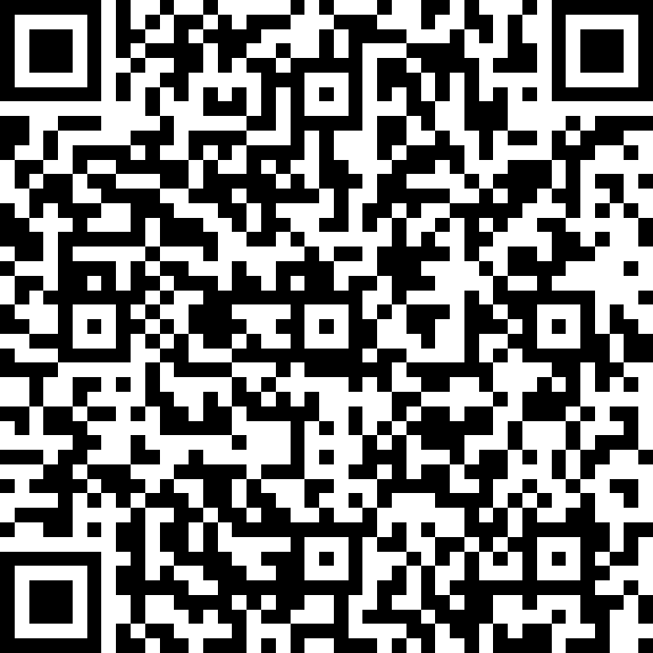
Your name and availability will be added to the participants list for future allocation in 2021.
Head to the
sign up form
How did you hear of WOL?
Be sure to mention:
Business Pilot
If you want to know more, and listen to testimonials:
Visit the Working Out Loud site
Notes:
Question 4 in the form: How did you hear of WOL at GE?
Be sure to mention:
Capital WCS Pilot
New circles will start in Q1 21. If January is a busy month for you, ask to start in February/March.

